Slide 1
MACHINE LEARNING
15 March – 20 March
Day1
Speaker- Krutika Vinchu

Slide 2





Content
1. Roadmap of our 6 days ML workshop
2. Introduction to ML
3. Python summary
4. IDE Installation
5. Variable and Data Types in Python

Slide 3



Roadmap
Day 1
Introduction to ML
IDE Installation
Python Variable & Data types
Day 2
Python basics ( loops, functions, conditional statements, Arrays, etc.)
Python project
Day 3
Python libraries
ML Introduction ( types, applications)
AI vs ML vs Deep Learning

Slide 4

Roadmap
Day 4
Importing data set
Data cleaning
Data preprocessing
Day 5
ML Algorithms
Naive Bayes
K means Clustering
Linear regression
Day 6
Hand on project session

Slide 5
Introduction
Machine Learning

Slide 6

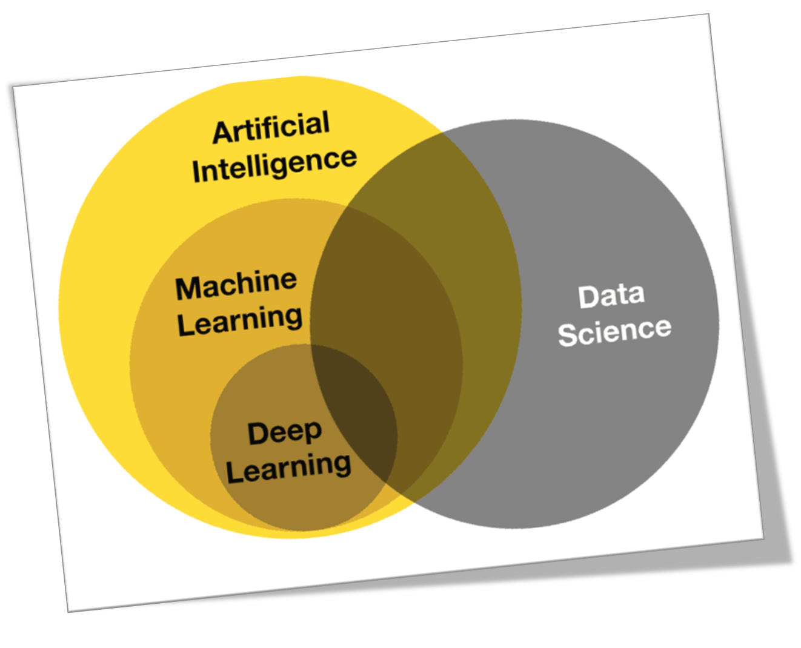

Slide 7
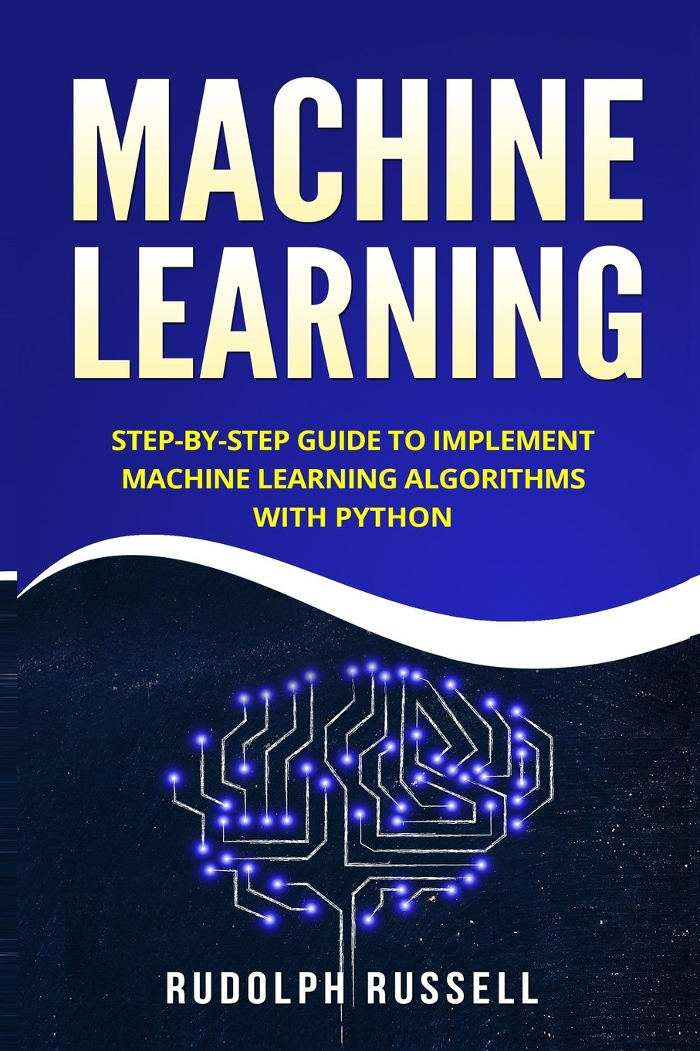
Machine learning is the practice of programming computers to learn from data” - Rudolph Russell

Slide 8

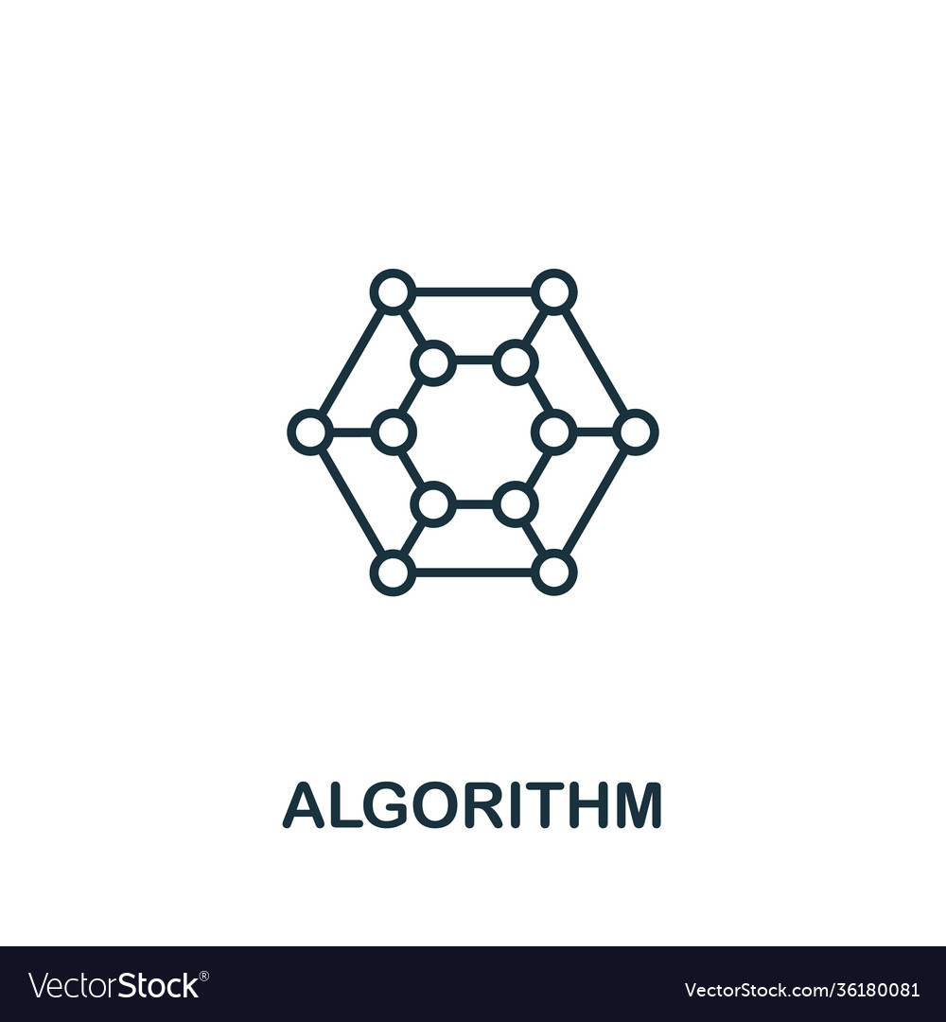
Overview
Data
algorithm

Slide 9

Python Programing
Introduction

Slide 10
Why python is popular?
Easy to use
Mature and Supportive Python Community
Hundreds of Python Libraries and Frameworks
Versatility, Efficiency, Reliability, and Speed
First-choice Language
The Flexibility of Python Language
Big data, Machine Learning and Cloud Computing

Slide 11
Use of python in industry
Desktop
GUI
Software
Development
Business Applications
wxWidgets
Kivy
Qt via pyqt
SCons
Apache gump
Roundup
Odoo
Tryton
Notes:
You can use this slide as your opening or closing slide. Should you choose to use it as a closing, make sure you review the main points of your presentation. One creative way to do that is by adding animations to the various graphics on a slide. This slide has 4 different graphics, and, when you view the slideshow, you will see that you can click to reveal the next graphic. Similarly, as you review the main topics in your presentation, you may want each point to show up when you are addressing that topic.
Add animation to images and graphics:
Select your image or graphic.
Click on the Animations tab.
Choose from the options. The animation for this slide is “Split”. The drop-down menu in the Animation section gives even more animations you can use.
If you have multiple graphics or images, you will see a number appear next to it that notes the order of the animations.
Note: You will want to choose the animations carefully. You do not want to make your audience dizzy from your presentation.

Slide 12




Career Opportunities
Software Engineer
DevOps Engineer
Data Scientist

Slide 13


Real world example of Python
Full content lifecycle
security automation
training machine learning models
Metaflow Python framework
easily execute machine learning projects through production
Open Connect
content delivery network
run infrastructures
network devices

Slide 14
Real world example of Python
Demand Engineering
Traffic Distribution
Capacity Operations
Regional Failovers
Fleet Efficiency
Information Security
risk classification
vulnerability identification
security automation
auto-remediation

Slide 15

PYTHON VARIABLE

Slide 16
Variable in python
a=python
b=3
Print(a+str(b))
:python3
del “var_name”
del a
a=100
Print(a)
:100
Reserved memory location to store values
A variable is created the moment we first assign a value to it.
1. Declare and Use a variable
3. Delete a variable
The value stored in a variable can be changed during program execution.
2. Concatenate Variables
Variables do not need to be declared with any particular type, and can even change type after they have been set.

Slide 17

Start with a letter or the underscore
Cannot start with a number
Contain alpha-numeric characters and underscores (A-z, 0-9, and _ )
case-sensitive (age, Age, AGE)
Camel Case
myVariableName = “SIGCE"
Pascal Case
MyVariableName = " SIGCE "
Snake Case
my_variable_name = " SIGCE "
Type
Casting
Quotes
x = str(3) # x will be '3'
y = int(3) # y will be 3
z = float(3) # z will be 3.0
x = ‘’HackClubSIGCE"
x = 'HackClubSIGCE’ }both are same
x = 5
print(type(x))
:: <class 'int'>
a = 4
A = "SIGCE"
One value to multiple variable
x, y, z = “Hack", “Club", “SIGCE"
x, y, z = “HackClubSIGCE"
Assign Multiple Values
Naming
Convention
Case Sensitive

Slide 18

Variables in python
PyObject
Integer
1
Type
Reference
count
X = 543
Value
543
X
X = 142
PyObject
Integer
1
Type
Reference
count
Value
142

Slide 19
Variables in python
PyObject
Integer
1
PyObject
Integer
2
X = 543
Type
X
Type
Reference
count
X = 142
Reference
count
Value
142
Y
Value
142
Y = X
Del X

Slide 20
Variables in python
X = 543
PyObject
Integer
1
X = 142
Type
Y
Reference
count
Y = X
Value
142
Del X

Slide 21
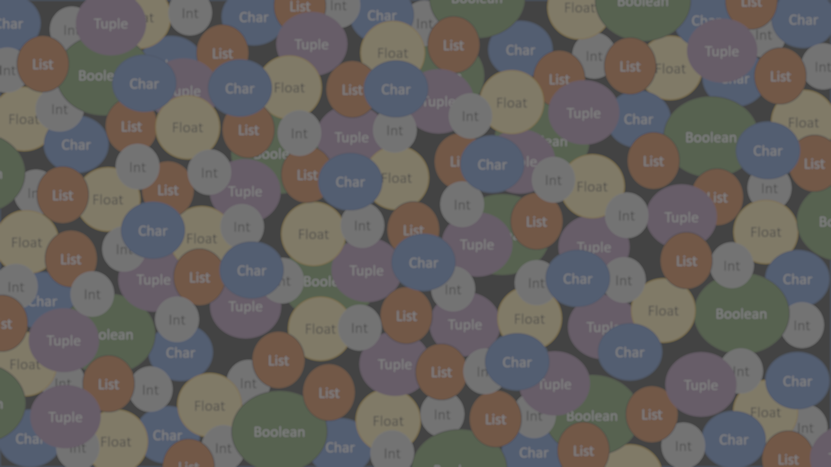
PYTHON
DATA TYPES

Slide 22
Data Types In Python
Sequence
Text
Mapping
Set
Numeric
Boolean

Slide 23
Data Types In Python
Sequence
Bool
Text
Mapping
Set
Numeric
Boolean
String
Set
List, Tuple
Dictionary
Int, Float, Complex

Slide 24
Data Types In Python
Slicing
Modify
Concatenate
Text
(String)
Format
Methods

Slide 25
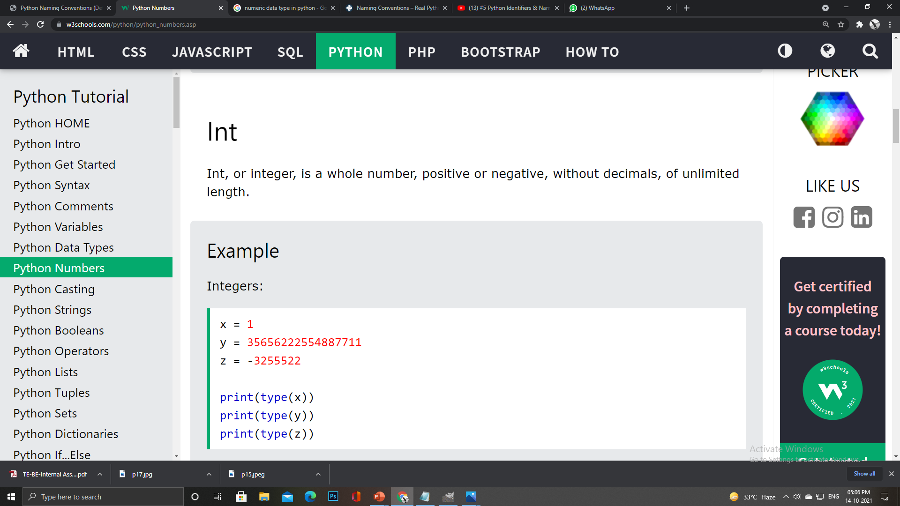
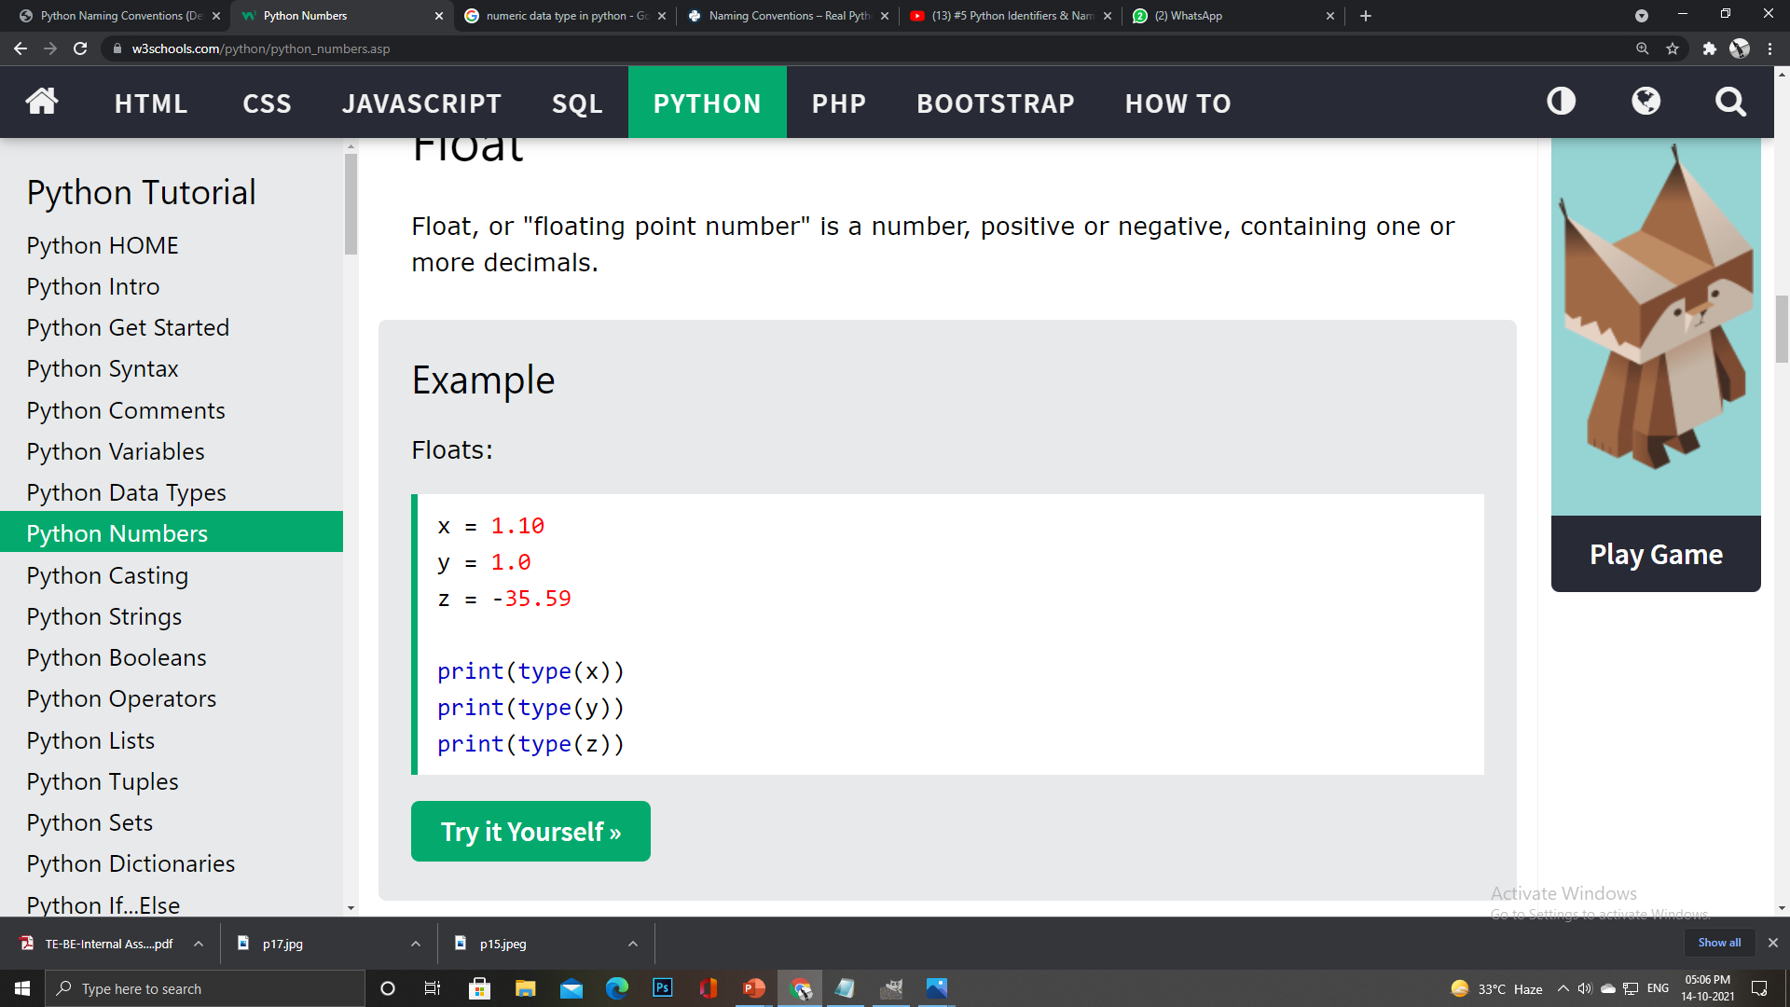
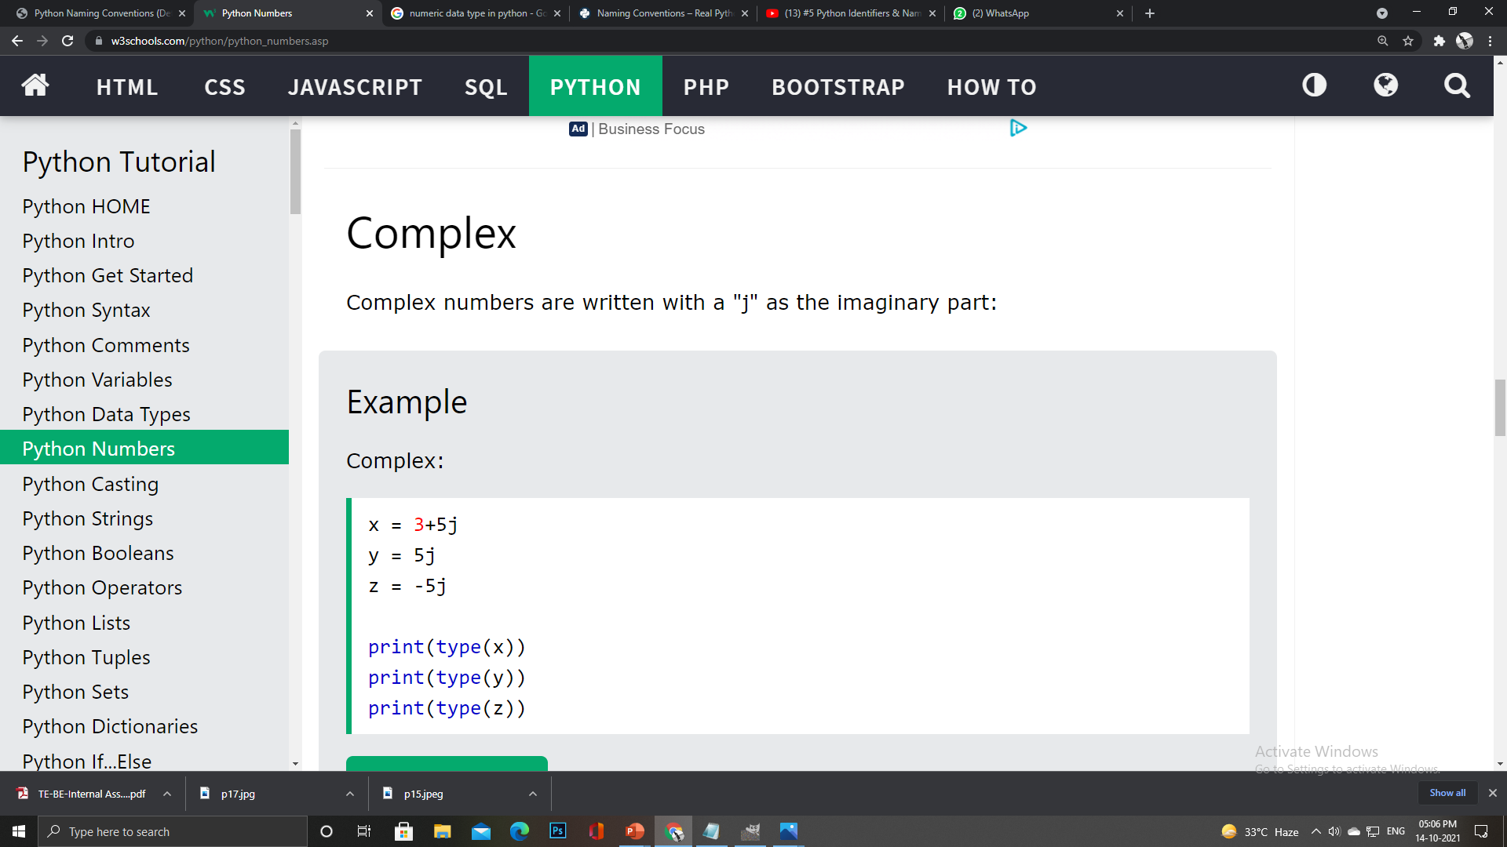
Data Types In Python
Numeric
(int, float,
complex)
Integer
Float
Complex

Slide 26
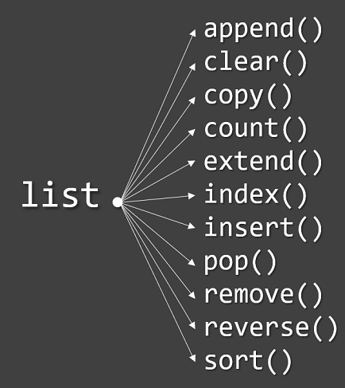
Data Types In Python
My_list = [“Hack", “Club", “SIGCE"]
Sequence
(List)
Multiple items in a single variable
List items are ordered, changeable, and allow duplicate values.
A single list may contain Data Types like Integers, Strings, as well as Objects
Lists are mutable, and hence, they can be altered even after their creation.

Slide 27
Data Types In Python
Sequence
(Tuple)
Access
Update
ordered and immutable
Methods
Tuples are written with round brackets.
tup1 = ('physics', 'chemistry', 1997, 2000);
tup2 = (1, 2, 3, 4, 5 );
tup3 = "a", "b", "c", "d";

Slide 28
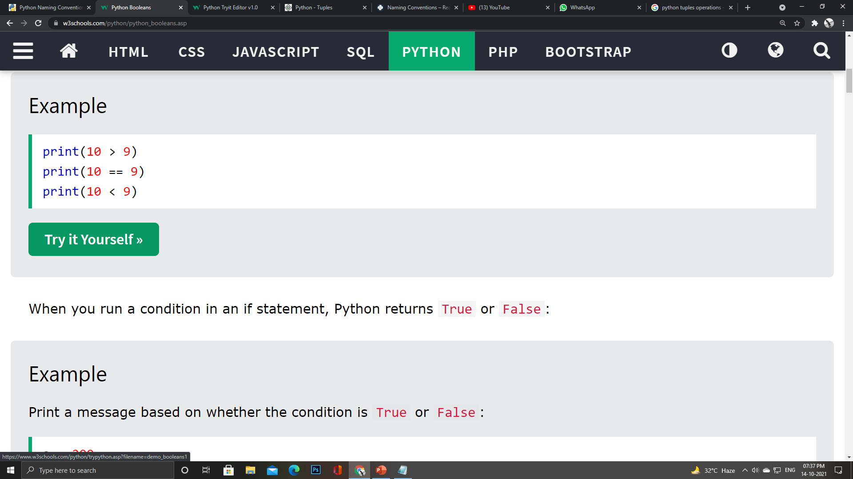
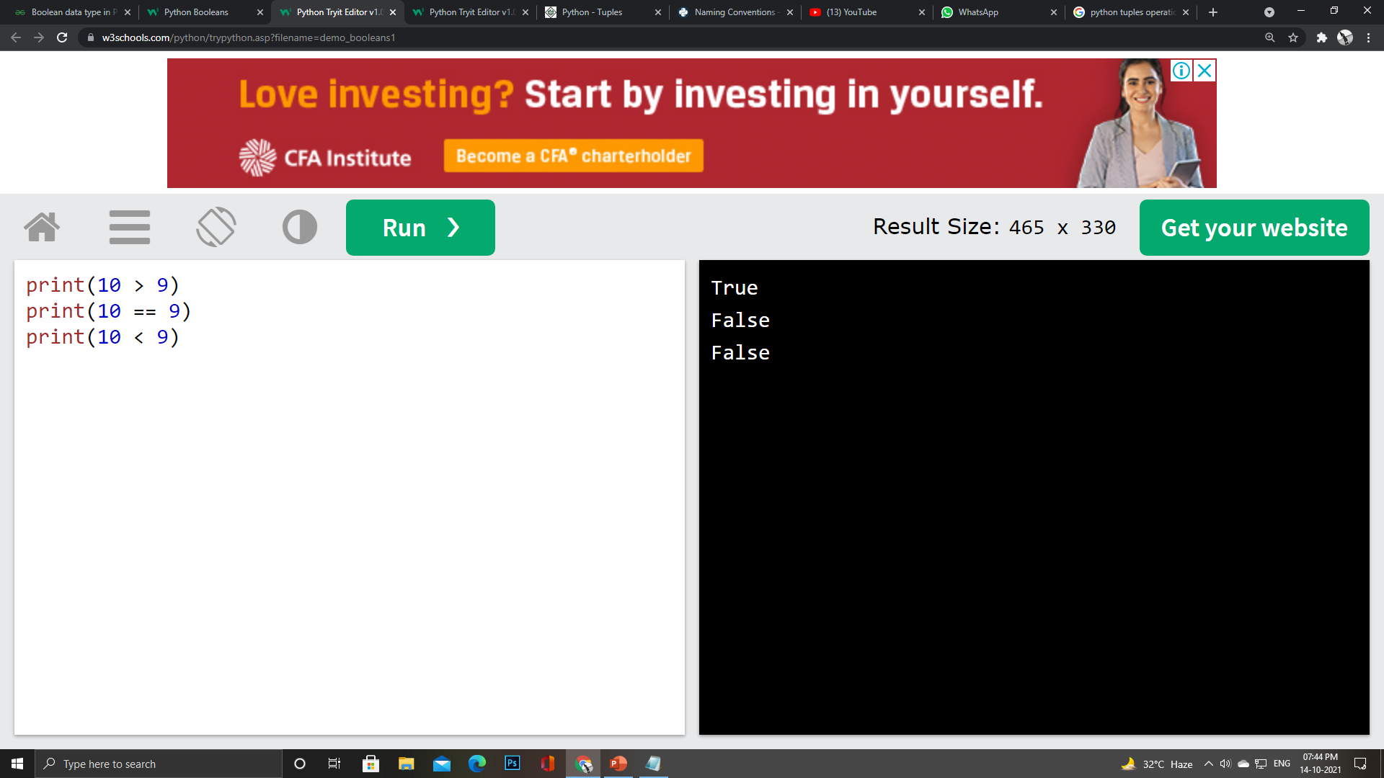
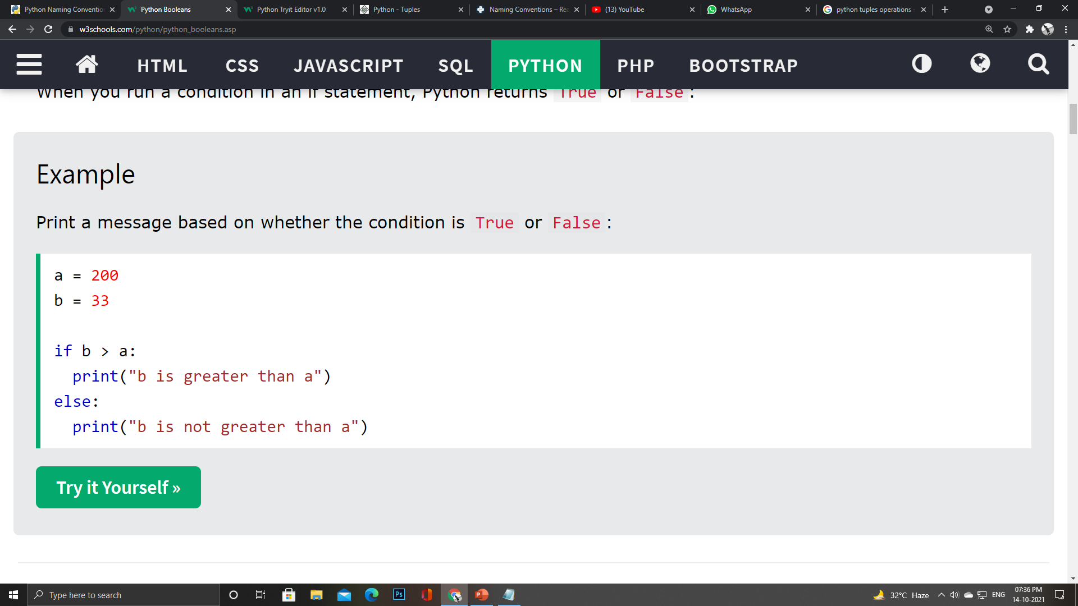
Data Types In Python
Boolean
Represents one of the two values i.e. True or False
Used to represent the truth values of the expressions
True and False must have an Upper Case first letter

Slide 29
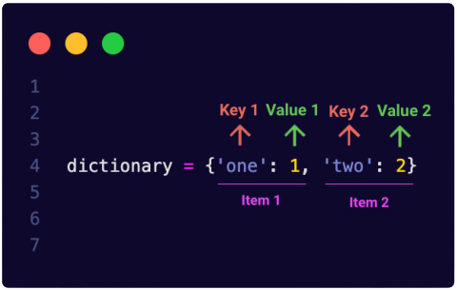
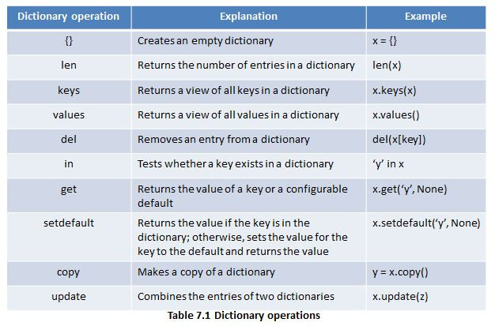
Data Types In Python
Mapping
(Dictionary)
Store data values in key : value pairs.
A dictionary is a collection which is ordered, changeable and does not allow duplicates.
Dictionaries are written with curly brackets, and have keys and values:

Slide 30
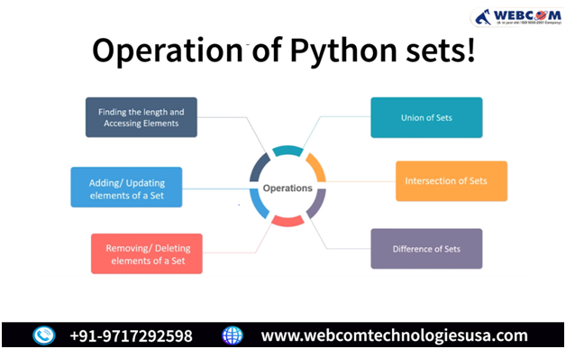
Data Types In Python
My_set = {“Hack", “Club", “SIGCE”}
Sets
A set is a collection which is both unordered and unindexed.
Once a set is created, you cannot change its items, but you can add new items.

Slide 31
Thank You

